Slide 1
Domain Masterclass
GTM (Engineering 🤣)
2025-04-16 B.H.

Slide 2
Quick intro
Ran a recording studio back in the day (this was my first sales job)
First startup was a music education media and software company
Sold motorcycles (selling motorcycles is more fun than selling SaaS but the pay sucks)
Was an SDR at PandaDoc (unicorn E-signature Saas, Series C)
SDR at Lightyear (Telecom Procurement SaaS, Series B)
Sales @ Cyft :)
From Marietta GA
Have a Xoloitzcuintli (Mexican hairless dog)

Slide 3
What is GTM Engineering?
GTM Engineering Is:
Taking a hacker's mindset to sales & revenue problems - building a network of point solutions instead of buying them
Creating bespoke automation workflows that eliminate manual busywork across the entire customer lifecycle
Applying AI and integration engineering to solve specific bottlenecks in your GTM motion
Ex: tracking customer sentiment across discord, LinkedIn and email threads by feeding scraped data to Intercom
It Is NOT:
Spraying and praying with lead lists
Just automating top-of-funnel activities
Basic integrations between common platforms
Only focused on acquisition
The GTM Engineer's Toolkit:
Custom API integrations
AI/LLM implementation
Workflow automation
Internal tooling development
Clay, Make, OpenAI APIs, Cursor
Custom bots & agents

Slide 4
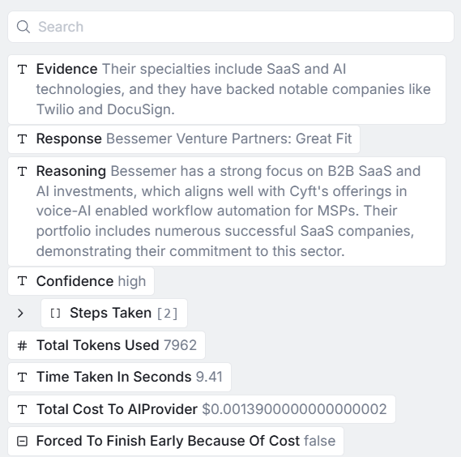
Investor Analysis
Analyze {{investor-name company}} website at {{URL}} and LinkedIn at {{linkedin url}}
to determine potential fit for Cyft, a voice-AI enabled workflow automation platform for MSPs:
DISQUALIFY IF:
- Clear vertical focus incompatible with B2B SaaS (e.g., biotech only, cannabis only, real estate only)
GREAT FIT IF ANY OF:
- B2B SaaS investments visible
- AI company investments visible
- IT services/MSP software investments visible
MEDIUM FIT IF:
- Not disqualified
- General tech investor without clear incompatibility
DEFAULT TO "NEEDS ATTENTION" IF:
- Insufficient public information to make determination
- Unclear investment focus
- Investment thesis not publicly visible
OUTPUT:
{Firm Name}: [Great Fit / Medium Fit / Disqualified / Needs Attention]
Reason: [1-2 sentences explaining categorization]
Evidence: [Key data point that drove decision, if any]

Slide 5
Old vs New
Sales isn’t different now than it ever was. But early stage sales is about building assembly line equipment.
Old old way: Paper marketing, direct mail, trade shows, radio ads, industry publication ads. Sales people making “cold calls” ie going to businesses to prospect customers
Old way: Repeatable revenue model, founder led sales until 5-10m ARR, hire first sales person, and once PMF is achieved, support a large SDR team with huge marketing expenditure. List building just involved pulling a list based on company size and industry categories which are not very good or accurate.
Ex. I attended Rewst webinars and they still reached out to me even tho I’m not in their ICP. Easily solvable with Clay Software cost vs labor cost (even for jr level sales rep)
New way:
Hyper targeted email/phone/ad campaigns
Deep research done on every contact and account to prioritize outreach
Multiple layers of signals to “pre-qualify” as best we can
Enables us to keep a lean team with high conversion rates
Eventually scale to full cycle AEs with a TOFU run by GTM team (GTME, Marketing Ops, Revops) as opposed to a bunch of SDRs making poor first impressions on buyers

Slide 6
Problem with new way
Despite having all this “stuff,” so to speak, we still need to just start conversations with people… The sales skills of the “old old” way are still more important than any fancy workflow.
We’re just getting to the conversations faster with people we believe will want to engage
Even if our assumptions are wrong, people will appreciate that we took the time to come to them, which most people don’t.
We’re going to enable our team to make a much better first impression on our prospects, and continue that automated research throughout the sales cycle from actual purchase to renewals/upsells.
The difference between those that can and can’t successfully leverage new GTM technology will still be salesmanship as it’s always been.
Automation scales what you’re currently doing. If you’re currently sucking, it’s going to scale that.
We still need to be a top 1% team natty to be top 1% on tren
Sidenote: most people are not willing to take the time do what we’re willing to do. If you put just a LITTLE bit of creativity into your outreach it will yield 10x results

Slide 7
Be. Different.
Main thing you have to do is just be different, if you can do that, the medium doesn’t matter.
It’s true in the music business. Dating. Cars. Anything.
Ex. Send an email with login credentials already made (easy to do with AI)
Push the envelope farther than you think it should be pushed. It will upset some people but captivate many more.
Focus on less leads
Build an AI/Automation “layer” for the sales engine
Recruit AI native sellers who are applying these principles to their work in addition to actually being great sellers

Slide 8
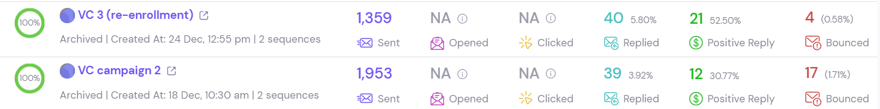
results
Vcs actually like it when you email them, it makes their job easier
Don’t let anyone tell you that outbound is dead

Slide 9
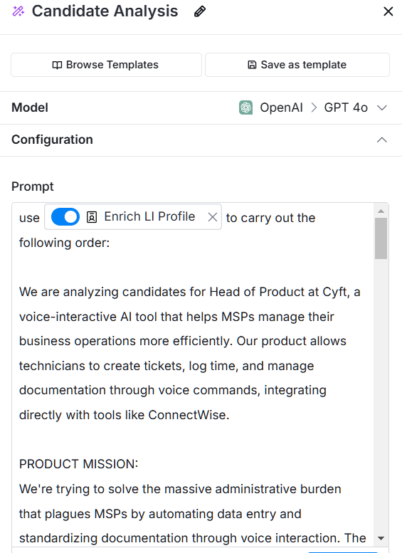
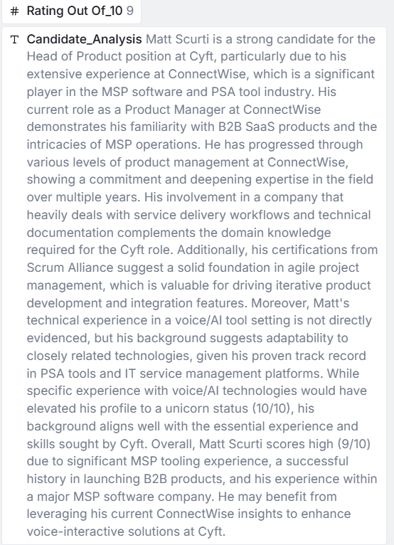
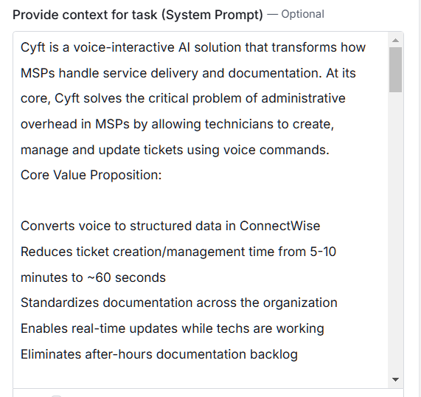
Using AI for recruiting

Slide 10
Pm campaign results
Encouraged them to text me/respond using personal email hence “low” response rate

Slide 11
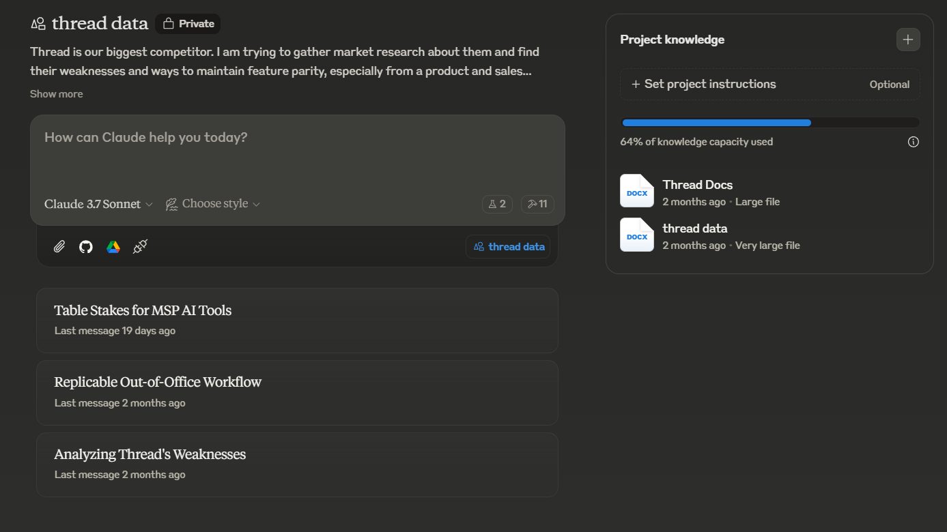
Use cases
Market Positioning and Differentiation
Product Development Strategy
Competitive Sales Playbook
Customer Acquisition Strategy
Offer premium features that Thread charges for (like Magic AI at $9 per client) at more attractive price points
Identify key integration partners Thread doesn't support well and build stronger connections
Study Thread's potential UX pain points (like their complex channel/flow setup) to create more intuitive alternatives
I personally used it for some Miro whiteboard to figure out what is tablestakes for MSP AI tools

Slide 12
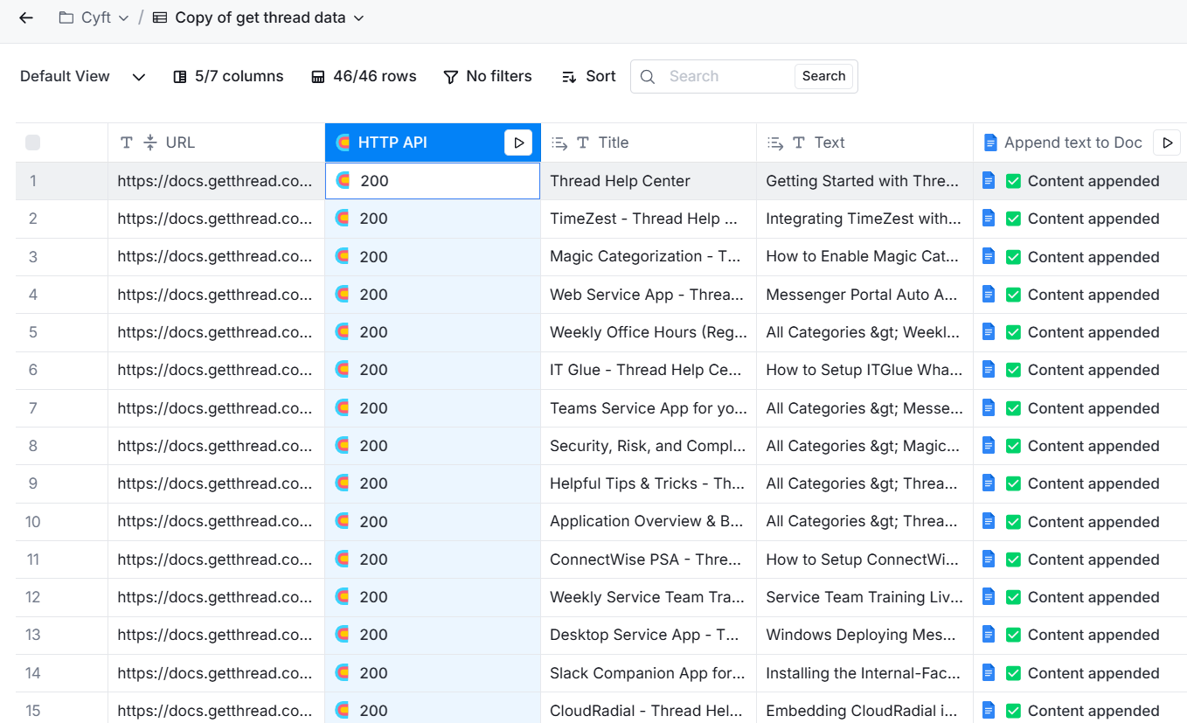
Copying a competitor's data
Use Exa API, probably in their support docs is the best place to start
“Append” to Google doc
Upload doc to Claude/ChatGPT
… Profit?
There’s other better/easier ways to scrape data, this isn’t going to work for all companies, but you’d be amazed at what people leave on the web. One of our biggest competitors has his whole roadmap and feature request page on his site public

Slide 13
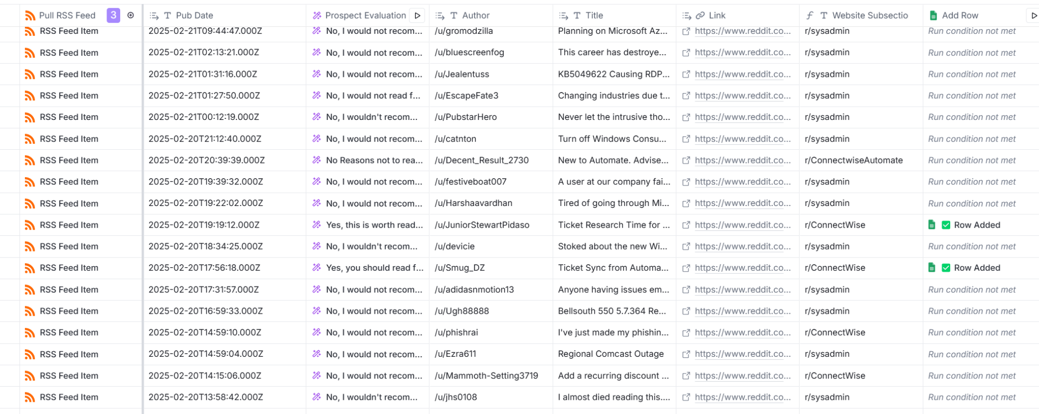
Scraping reddit

Slide 14
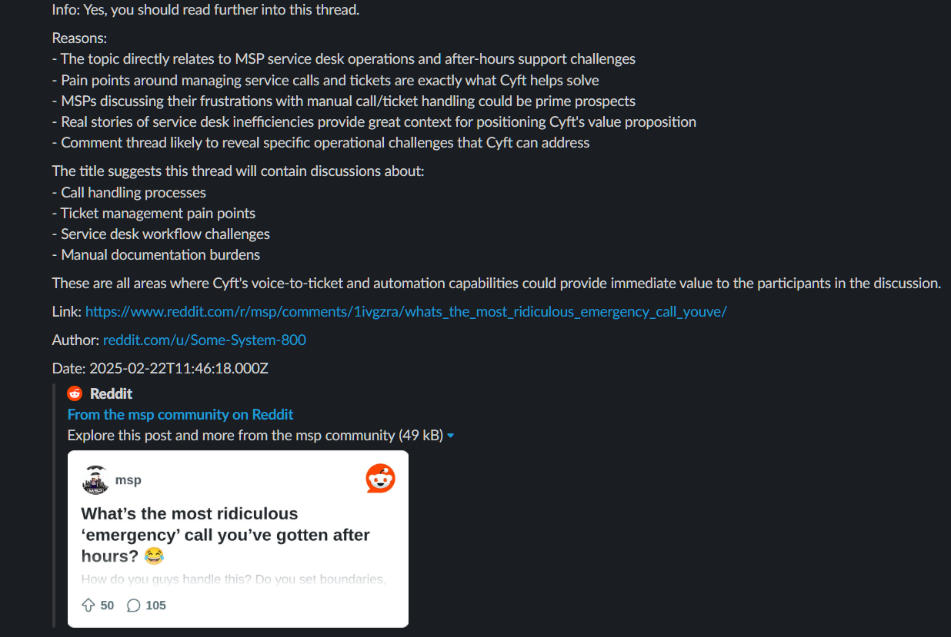
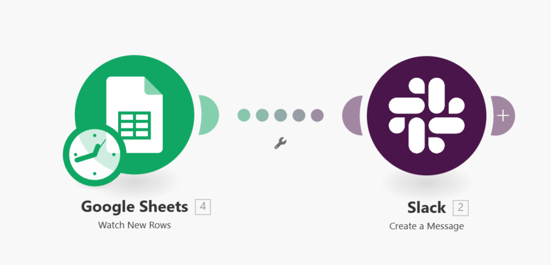
Scraping reddit

Slide 15
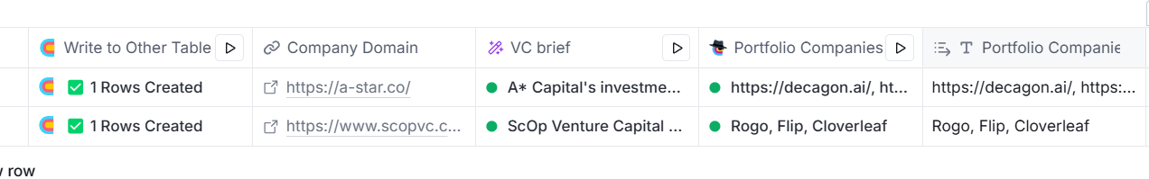
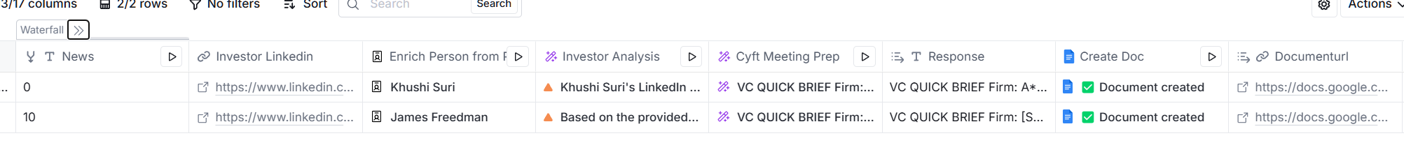
Meeting prep Docs to slack

Slide 16
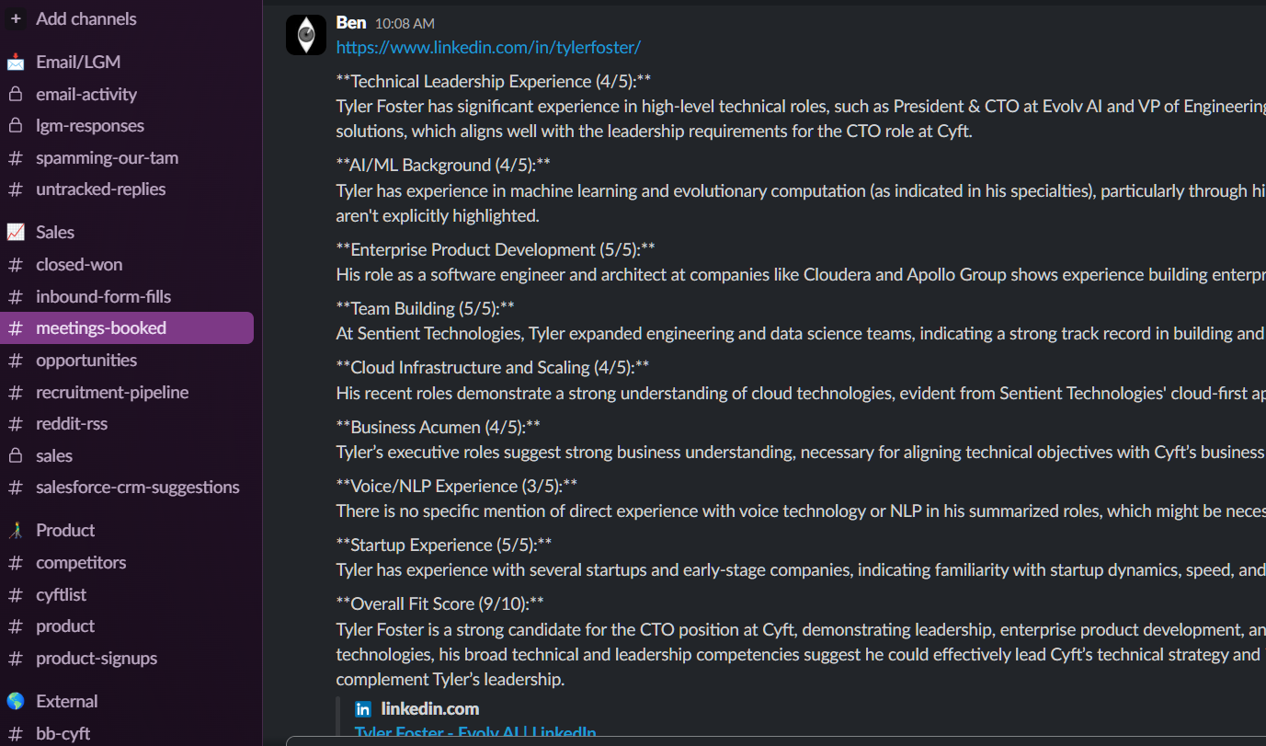
Meeting prep Docs to slack

